Slide 1
Workshop on AngularJS and NodeJS
Everybody in the country should learn to program a computer because it teaches you how to think - Steve Jobs

Slide 2
AngularJS is mainly used to build single page web (SPA) applications

Slide 3
Single Page Application
Web applications dynamically re-write the current web page with new data from the web server in the background using XHR requests (XML HTTP requests), without refreshing the web browser. E.g., new mail in mailbox is directly written without it being refreshed.
SPA apps load a single page with very low content to start with and then dynamically generate contents with XHR requests. Hence, SEO is tough.

Slide 4
Features of SPA
HTTP communication with XHR
DOM manipulation
If you are navigating to different sites in SPA application, the top URL doesn’t change. i.e., no separate URL is created for each navigation.
Many frameworks are designed to build SPA’s. E.g, AngularJS, ReactJS, ember, Vue.js etc.

Slide 5
Separation of Concern (SoC)
Separation of Concerns (SoC) is a design principle that manages complexity by partitioning the software system so that each partition is responsible for a separate concern, minimizing the overlap of concerns as much as possible.

Slide 6
What do you mean by a framework?

Slide 7
AngularJS
A Google employee started working with AngularJS in 2009, and later it was officially supported by google. Hence, all google apps are built using AngularJS.
AngularJS is a JavaScript framework written in JavaScript. The webpages designed in AngularJS are a mix of JS and HTML.
AngularJS follows MVC architecture.
AngularJS is built to follow SoC principal.
People choose AngularJS for its speed of execution.

Slide 8
AngularJS can be added to an HTML page with <script> tag
<script src="https://ajax.googleapis.com/ajax/libs/angularjs/1.6.9/angular.min.js"></script>
Try it out
Try and google to see what is there in the above link.

Slide 9


Slide 10
What are AJAX and Google API’s in above link

Slide 11
Ajax
Asynchronous JS And XML: A technique in which data is requested from a remote server without re-loading the entire page.
Ajax is not a programming language. It is a technique developed using following: HTML, CSS for client side, JS for making requests with server, XML and JSON are request formats and PHP for server side.

Slide 12
Ajax
Asynchronous refers to requests/post data to the server in the background without the need to refresh the page.
A specific part of page is modified. I.e., only the content that is changing is modified. The rest all remain the same. For example, if you are navigating within a YouTube playlist, the headers, footers, menus etc. remain the same. The only thing modified is the center part. Another example can be tracking a cricket score board in a live match.

Slide 13
Google API’s
Google provides a set of API’s for the general public to use. To check out, go to: https://developers.google.com/apis-explorer

Slide 14


Slide 15
AngularJS MVC Architecture
An AngularJS application is split into 3 main components:
Model: Details with data/Database
Views: Used to display data/contents to the end users in a presentable format using HTML.
Controllers: JS code to act as a bridge between model and view to control and manage the functionality of views.

Slide 16
An example of how MVC architecture works
01
User clicks on “Show users” button
The “UserController” recognizes the button click event and performs necessary tasks/function.
02
03
The function communicates with the “Users” model (database) and retrieves all user data.
The controller then passes this data to the view, which then displays it to the end user.
04

Slide 17





Applications built in AngularJS
Microsoft OneDrive
Netflix
PayPal
Forbes
Google applications

Slide 18
Tools needed
Editor: Any editor such as: Atom, VS code, sublime, etc)
Node.js: for package manager(npm) (download Node.js from Google)- post installing, check the version (node -v) in command prompt. Also check the npm version (npm -v).

Slide 19
A few basics required before getting started.

Slide 20
Directives
Directives are used to add functionality to the application.
Directives are used for enhancing the interactivity, functionality, and appearance of HTML elements by attaching specific actions or capabilities to them.

Slide 21





A few AngularJS Directives:
05
04
03
02
ng-repeat
01
ng-init
ng-bind
ng-model
This directive repeats HTML elements for each item in a collection.
ng-app
This directive is used to initialize application data.
This directives binds the values of HTML controls (such as input, select, textarea etc) into application data.
The directive binds the AngularJS application data into HTML views.
This directives binds the values of HTML controls (such as input, select, textarea etc) into application data.

Slide 22
2 way data binding
Data binding refers to automatic synchronization of data between model and view components. Implies, if you are trying to change the data in view layer, the same is reflected in model layer and vice versa.

Slide 23
What is the difference between 2-way data binding and 1-way data binding?
In one-way data binding, the data is taken from the model and presented it to the views only. Vice versa is not possible. Whereas in 2-way data binding both scenarios are possible.

Slide 24
Running the AngularJS application on localhost:
Install a local server “http-server”: npm install -g http-server
01
Download and install Node.js.
02
Navigate to your project location using cd command.
Serve your AngularJS application: http-server
03
04

Slide 25
Let’s code to understand the concept of 2-way data binding:

Slide 26
Step 1
Create a basic html page.
<!DOCTYPE HTML>
<html lang = "en">
<head>
<title>FirstExample</title>
</head>
<body>
<h1>Sample Application</h1>
</body>
</html>

Slide 27
Step 2
Add/Load AngularJS framework into the HTML script
<!DOCTYPE HTML>
<html lang = "en">
<head>
<title>FirstExample</title>
<script src="https://ajax.googleapis.com/ajax/libs/angularjs/1.6.9/angular.min.js"></script>
</head>
<body>
<h1>Sample Application</h1>
</body>
</html>

Slide 28
Step 3
Define AngularJS application using ng-app directive.
<!DOCTYPE HTML>
<html lang = "en">
<head>
<title>FirstExample</title>
<script src="https://ajax.googleapis.com/ajax/libs/angularjs/1.6.9/angular.min.js"></script>
</head>
<body ng-app>
<h1>Sample Application</h1>
</body>
</html>

Slide 29
Step 4
Modify the above application to accept input from user
<!DOCTYPE HTML>
<html lang = "en">
<head>
<title>FirstExample</title>
<script src="https://ajax.googleapis.com/ajax/libs/angularjs/1.6.9/angular.min.js"></script>
</head>
<body ng-app>
<h1>Sample Application</h1>
<input type = "text" placeholder = "Write your text">
</body>
</html>

Slide 30
Step 5
Define a model name using ng-model directive
<!DOCTYPE HTML>
<html lang = "en">
<head>
<title>FirstExample</title>
<script src="https://ajax.googleapis.com/ajax/libs/angularjs/1.6.9/angular.min.js"></script>
</head>
<body ng-app>
<h1>Sample Application</h1>
<input type = "text" ng-model = "textPrinter" placeholder = "Write your text">
</body>
</html>

Slide 31
Step 6
Bind the value of above model using ng-bind directive
<!DOCTYPE HTML>
<html lang = "en">
<head>
<title>FirstExample</title>
<script src="https://ajax.googleapis.com/ajax/libs/angularjs/1.6.9/angular.min.js"></script>
</head>
<body ng-app>
<h1>Sample Application</h1>
<input type = "text" ng-model = "textPrinter" placeholder = "Write your text">
<p>The text entered is <span ng-bind = "textPrinter"/> </p>
</body>
</html>

Slide 32
Writing an AngularJS code to accept first name and last name from user and display the same.
<!DOCTYPE HTML>
<html lang = "en">
<head>
<title>FirstNameAndLastName</title>
<script src="https://ajax.googleapis.com/ajax/libs/angularjs/1.6.9/angular.min.js"></script>
</head>
<body ng-app>
<h1> Enter first name </h1>
<input type="text" ng-model = "firstName" placeholder="first name">
<h1> Enter last name </h1>
<input type="text" ng-model = "lastName" placeholder="last name">
<h2>The entered name is <span ng-bind="firstName + ' ' + lastName"/>
</body>
</html>

Slide 33
Writing an AngularJS code to understand ng-init:
<!DOCTYPE HTML>
<html lang = "en">
<head>
<title>MathExpression</title>
<script src="https://ajax.googleapis.com/ajax/libs/angularjs/1.6.9/angular.min.js"></script>
</head>
<body ng-app>
<h1>Sample Math Operation</h1>
<h1 ng-init = "internal_marks=35;external_marks=30"> </h1>
<h1>The total marks in M4 is {{internal_marks + external_marks}}</h1>
</body>
</html>

Slide 34
Writing an AngularJS code for working with expressions, JSON data, array.
<!DOCTYPE HTML>
<html lang = "en">
<head>
<title = "MathExpression"></title>
<script src="https://ajax.googleapis.com/ajax/libs/angularjs/1.6.9/angular.min.js"></script>
</head>
<body ng-app>
<h1>Sample Math Operation</h1>
<p ng-init = "internal_marks=35;external_marks=30;
student = {firstname:'Varun',lastname:'Bhat',USN:103};
marks = [80,90,75,73,60]"></p>
<p>Hello {{student.firstname + " " + student.lastname}}!</p>
<p>Marks in M4 : {{internal_marks + external_marks}} marks</p>
<p>USN No: {{student.USN}}</p>
<p>Marks(Math): {{marks[3]}}</p>
</body>
</html>

Slide 35
Creating Forms in AngularJS and also performing form validations.

Slide 36
Forms
A form facilitates the user to enter data that is to be sent to the server for processing such as name, email address, password, phone number, etc. .
HTML forms are required if you want to collect some data from of the site visitor.
For example: If a user want to purchase some items on internet, he/she must fill the form such as shipping address and credit/debit card details so that item can be sent to the given address.

Slide 37
A few form directives
in AngularJS
1. ng-required: to specify a form field is required.
2. ng-show: Shows the value of a Boolean if the value is true.
3. ng-disabled: Disable a particular field util the conditions are satisfied.

Slide 38
Lets design a form in AngularJS

Slide 39
Step 1
Creating a basic form
<!DOCTYPE HTML>
<html lang = "en">
<head>
<title>Form</title>
<script src="https://ajax.googleapis.com/ajax/libs/angularjs/1.6.9/angular.min.js"></script>
</head>
<body ng-app>
<form name = "RegistrationForm">
<input type = "text" placeholder = "name" name = "fname" />
<input type = "email" placeholder = "Email" name = "mail" />
<input type = "submit" value = "send" />
</form>
</body>
</html>

Slide 40
Step 2
Adding novalidate attribute in the form tag to ignore HTML form validation (browser's native form validation) and take up AngularJS form validation.
<body ng-app>
<form name = "RegistrationForm" novalidate>
<input type = "text" placeholder = "name" name = "fname" />
<input type = "email" placeholder = "Email" name = "mail" />
<input type = "submit" value = "send" />
</form>
</body>

Slide 41
Step 3
Using ng-required directive to make form fields required.
<body ng-app>
<form name = "RegistrationForm" novalidate>
<input type = "text" placeholder = "name" name = "fname" ng- required="true"/>
<input type = "email" placeholder = "Email" name = "mail" ng- required="true" />
<input type = "submit" value = "send" ng-required="true" />
</form>
</body>

Slide 42
Step 4
Adding a model to each form filed.
<body ng-app>
<form name = "RegistrationForm" novalidate>
<input type = "text" placeholder = "name" name = "fname" ng-model = "name" ng-required="true"/>
<input type = "email" placeholder = "Email" name = "mail" ng-model = "email" ng-required="true" />
<input type = "submit" value = "send" ng-required="true" />
</form>
</body>

Slide 43
Try it out
Run the created form and inspect in dev tools and check the various form controls and its values displayed there.
Also try entering fields in form (both right and wrong entries) and see how the form class values change.

Slide 44
Getting started with form validation:

Slide 45
Various form classes/
properties
In AngularJS, forms and form controls come with several properties that allow you to access and manipulate their states, validation of information, and user interactions.
These properties are helpful for managing form behavior, validation, and user input handling.

Slide 46






ng-invalid
Returns true when the data entered in the form field is incorrect.
ng-pristine
Returns true when the form is not yet modified.
d
One
Two
ng-dirty
This class returns true when the user has entered some value in the form.
ng-valid
Returns true when the data entered in form filed is correct
A few form classes
Six
Three
Five
d
d
Four
Returns true when the form fields have been touched (even if you click in the field, the form is touched).
ng-touch
Returns true when the fields of form are untouched
ng-untouched
d

Slide 47
Form properties: The value of form class (true/false) can be accessed using the properties of that class.
Class | Property
ng-pristine | $pristine
ng-dirty | $dirty
ng-touched | $touched
ng-valid | $valid
ng-invalid | $invalid

Slide 48
Step 5
We can use ng-show command along with form property to check if the entered data in the field is valid or not.
Syntax: ng-show = formName.fieldName.$property
<body ng-app>
<form name = "RegistrationForm" novalidate>
<input type = "text" placeholder = "name" name = "fname" ng-model = "name" ng-required="true"/>
<span ng-show = "RegistrationForm.fname.$touched && RegistrationForm.fname.$invalid">Enter a valid name</span>
<input type = "email" placeholder = "Email" name = "mail" ng-model = "email" ng-required="true" />
<span ng-show = "RegistrationForm.mail.$touched && RegistrationForm.mail.$invalid">Enter a valid email</span>
<input type = "submit" value = "send" ng-required="true" />
</form>
</body>

Slide 49
Step 6
Disabling submit button until all filed validations are satisfied.
<!DOCTYPE HTML>
<html lang = "en">
<head>
<title>Form</title>
<script src="https://ajax.googleapis.com/ajax/libs/angularjs/1.6.9/angular.min.js"></script>
</head>
<body ng-app>
<form name = "RegistrationForm" novalidate>
<input type = "text" placeholder = "name" name = "fname" ng-model = "name" ng-required="true"/>
<span ng-show = "RegistrationForm.fname.$touched && RegistrationForm.fname.$invalid">Enter a valid name</span>
<input type = "email" placeholder = "Email" name = "mail" ng-model = "email" ng-required="true" />
<span ng-show = "RegistrationForm.mail.$touched && RegistrationForm.mail.$invalid">Enter a valid email</span>
<input type = "submit" value = "send" ng-disabled="RegistrationForm.$invalid" />
</form>
</body>
</html>

Slide 50
Assignment
Try out a few other form fields and validations of your own to understand forms much better. A few are as given below:
Accept phone number from user.
Accept age from the user. Make sure the age entered is between 18 to 60.
Accept gender from user in the form of radio buttons.
Accept DoB. Perform a few validations like age entered must match with the DoB entered.
Accept password from user. Make sure the password entered contains one special character, one capital letter, one small letter, one number etc.
If still not satisfied, try for captcha validation.

Slide 51
Getting started with controllers

Slide 52
Working with controllers
Controllers play a crucial role in structuring and controlling the application logic on the client side.
They are responsible for handling user interactions, manipulating data, and updating the view.
Imagine a Gmail application, the entire application is divided into n-modules. Lets' say the first module is the inbox, the second is sent mail, the third module is starred and so on. In all these different modules, the functionality of views, controllers, models, filters etc. remain the same. So, let’s just try and build a generic controller to print student name and USN.

Slide 53
Step 1
Creating a basic HTML template for our webpage
<!DOCTYPE HTML>
<html lang = "en">
<head>
<title = "ng-controller"></title>
<script src="https://ajax.googleapis.com/ajax/libs/angularjs/1.6.9/angular.min.js"></script>
</head>
<body>
</body>
</html>

Slide 54
Step 2
A module can be created inside script tag:
Syntax: var variable_name = angular.module("module_name",[])
<!DOCTYPE HTML>
<html lang = "en">
<head>
<title>ng-controller</title>
<script src="https://ajax.googleapis.com/ajax/libs/angularjs/1.6.9/angular.min.js"></script>
<script>
var app = angular.module("studentApp", [])
</script>
</head>

Slide 55
Here:
angular is the predefined object (similar to predefined objects in java).
module: A function defined in angular object for creating modules.
[]: If there is any dependency of one module on other, that module is defined inside []. Dependency injection is achieved in AngularJS using [].
Multiple modules are separated by ",".

Slide 56
Step 3
Creating a view for the created model “studentApp”: A view can be created using
Syntax: ng-app = “module_name”
<!DOCTYPE HTML>
<html lang = "en">
<head>
<title = "ng-controller"></title>
<script src="https://ajax.googleapis.com/ajax/libs/angularjs/1.6.9/angular.min.js"></script>
<script>
var app = angular.module("studentApp", [])
</script>
</head>
<body ng-app = "studentApp">
</body>
</html>

Slide 57
Step 4
Creating a controller in the form of a function: Syntax: variable_name.controller(“controller_name”,function($scope){})
$scope object:
Scope in AngularJS is a built-in object that acts as a binding part (communication bridge) between HTML (view) and JS (controller).
$scope object is created with ng-controller directive.
It is available only to the controller that has created it, i.e., the property assigned with “$scope” can’t be used outside the controller in which it is defined. Which implies, every controller will have its own scope, which is not shared with others.

Slide 58
Contd…
<!DOCTYPE HTML>
<html lang = "en">
<head>
<title = "ng-controller"></title>
<script src="https://ajax.googleapis.com/ajax/libs/angularjs/1.6.9/angular.min.js"></script>
<script>
var app = angular.module("studentApp", [])
app.controller("studentInfo", function($scope){
})
</script>
</head>
<body ng-app = "studentApp">
</body>
</html>

Slide 59
Step 5
Binding the $scope value with the data by creating an object for scope (student in our case as shown below) which can be used to access data later.
<script>
var app = angular.module("studentApp", [])
app.controller("studentInfo", function($scope){
$scope.student = {usn: "103", name: "Varun"}
})
</script>

Slide 60
Step 6
Mapping the specific controller to the specific module using ng-controller directive, as there can be many modules and controllers designed for a single application. And then, accessing the property using student object and displaying the value in the HTML body.
<!DOCTYPE HTML>
<html lang = "en">
<head>
<title = "ng-controller"></title>
<script src="https://ajax.googleapis.com/ajax/libs/angularjs/1.6.9/angular.min.js"></script>
<script>
var app = angular.module("studentApp", []);
app.controller("studentInfo", function($scope){
$scope.student = {usn: "103", name: "Varun"}
})
</script>
</head>
<body ng-app = "studentApp" ng-controller = "studentInfo">
<h1>The student USN is {{student.usn}} </h1>
<h1>The student name is {{student.name}} </h1>
</body>
</html>

Slide 61
The ng-repeat Directive
Angular-JS ng-repeat directive is a handy tool to repeat a set of HTML code for a number of times or once per item in a collection of items.
ng-repeat is mostly used on arrays and objects.
ng-repeat is similar to for loop in c/c++.

Slide 62
Step 1
Create a basic HTML template for AngularJS
<!DOCTYPE HTML>
<html lang = "en">
<head>
<title>ng-repeat</title>
<script src="https://ajax.googleapis.com/ajax/libs/angularjs/1.6.9/angular.min.js"></script>
</head>
<body>
</body>
</html>

Slide 63
Step 2
Create a module and a controller with multiple JSON data in it.
<head>
<title>ng-repeat</title>
<script src="https://ajax.googleapis.com/ajax/libs/angularjs/1.6.9/angular.min.js"></script>
<script>
app.controller("studentInfo", function($scope){
$scope.student = [
{usn: "103", name: "Varun", fine: "500"},
{usn: "108", name: "Yashas", fine: "100"},
{usn: "110", name: "Tarun", fine: "1000"}
];
});
</script>
</head>

Slide 64
Step 3
Create a view for the controller and map the controller with a specific module
<!DOCTYPE HTML>
<html lang = "en">
<head>
<title>ng-repeat</title>
<script src="https://ajax.googleapis.com/ajax/libs/angularjs/1.6.9/angular.min.js"></script>
<script>
var app = angular.module("studentDetails", []);
app.controller("studentInfo", function($scope){
$scope.student = [
{usn: "103", name: "Varun", fine: "500"},
{usn: "108", name: "Yashas", fine: "100"},
{usn: "110", name: "Tarun", fine: "1000"}
];
});
</script>
</head>
<body ng-app = "studentDetails" ng-controller = "studentInfo">
</body>
</html>

Slide 65
Step 4
Using ng-repeat to print all JSON data
<!DOCTYPE HTML>
<html lang = "en">
<head>
<title>ng-repeat</title>
<script src="https://ajax.googleapis.com/ajax/libs/angularjs/1.6.9/angular.min.js"></script>
<script>
var app = angular.module("studentDetails", []);
app.controller("studentInfo", function($scope){
$scope.student = [
{usn: "103", name: "Varun", fine: "500"},
{usn: "108", name: "Yashas", fine: "100"},
{usn: "110", name: "Tarun", fine: "1000"}
];
});
</script>
</head>
<body ng-app = "studentDetails" ng-controller = "studentInfo">
<h1 ng-repeat = "studentDet in student">The student USN and name is {{studentDet.usn}} : {{studentDet.name}} </h1>
</body>
</html>

Slide 66
Filters
In AngularJS, filters are a crucial feature that allows you to format, transform, and filter data displayed in views without altering the original data source.
Filters are primarily used within templates (HTML files) to modify the presentation of data bound to AngularJS expressions.
They are applied in templates using a pipe (|) symbol followed by the filter name and optional parameters.
Filters play a significant role in creating a more user-friendly and readable interface by presenting data in a desired format.
Syntax: {{ expression | filterName: parameter }}

Slide 67
A few important filters
Number
Search filter
01
Filter and display a subset of data based on a search query or keyword entered by the user.
Formats a number as text. It can specify decimal places and other formatting options
02
Date
06
OrderBy
Formats a date based on the specified format.
Orders an array by a specified expression.
03
Uppercase/Lowercase
05
Currency
Converts a string to upper/lower case
04
Formats a number to a currency format.

Slide 68
The search filter

Slide 69
The search filter in AngularJS is a functionality used to filter and display a subset of data based on a search query or keyword entered by the user
<!DOCTYPE HTML>
<html lang = "en">
<head>
<title>Filters</title>
<script src="https://ajax.googleapis.com/ajax/libs/angularjs/1.6.9/angular.min.js"></script>
<script>
var app = angular.module("studentDetails", []);
app.controller("studentInfo", function($scope){
$scope.student = [
{usn: "103", name: "Varun", fine: "500"},
{usn: "108", name: "Yashas", fine: "100"},
{usn: "110", name: "Tarun", fine: "1000"}
];
});
</script>
</head>

Slide 70
Contd…
<body ng-app = "studentDetails" ng-controller = "studentInfo">
<input type = "text" ng-model = "search">
<h1 ng-repeat = "studentDet in student | filter: search">The student USN and name is {{studentDet.usn}} : {{studentDet.name}} </h1>
</body>

Slide 71
The OrderBy filter

Slide 72
orderBy filter is used to sort an array of items based on a specified expression.
It allows you to dynamically arrange and display data in a specific order within your application's UI.
<!DOCTYPE HTML>
<html lang = "en">
<head>
<title>Filters</title>
<script src="https://ajax.googleapis.com/ajax/libs/angularjs/1.6.9/angular.min.js"></script>
<script>
var app = angular.module("studentDetails", []);
app.controller("studentInfo", function($scope){
$scope.student = [
{usn: "103", name: "Varun", fine: "500"},
{usn: "108", name: "Yashas", fine: "100"},
{usn: "110", name: "Tarun", fine: "1000"}
];
});
</script>
</head>

Slide 73
Contd…
<body ng-app = "studentDetails" ng-controller = "studentInfo">
<h1 ng-repeat = "studentDet in student | orderBy: 'usn'">The student USN and name is {{studentDet.usn}} : {{studentDet.name}} </h1>
</body>
</body>
</html>

Slide 74
The Currency filter
Currency filter is used to format a number as a currency. It takes a numeric input and converts it into a formatted currency string based on the specified currency symbol, precision, and other locale-specific formatting rules.

Slide 75
Applying multiple filters to a dataset and adding the currency filter.
<!DOCTYPE HTML>
<html lang = "en">
<head>
<title>Filters</title>
<script src="https://ajax.googleapis.com/ajax/libs/angularjs/1.6.9/angular.min.js"></script>
<script>
var app = angular.module("studentDetails", []);
app.controller("studentInfo", function($scope){
$scope.student = [
{usn: "103", name: "Varun", fine: "500"},
{usn: "108", name: "Yashas", fine: "100"},
{usn: "110", name: "Tarun", fine: "1000"}
];
});
</script>
</head>

Slide 76
Contd…
<body ng-app = "studentDetails" ng-controller = "studentInfo">
<input type = "text" ng-model = "search">
<h1 ng-repeat = "studentDet in student | orderBy: 'usn' | filter: search">The student details are {{studentDet.usn}} : {{studentDet.name}} : {{studentDet.fine | currency}}</h1>
</body>
</html>

Slide 77
In the above example, the currency displayed is in US “$” by default. If you want to change the same to any other format along with some decimal values, you can use the below mentioned.
Syntax: {{ amount | currency: 'symbol': decimalPlaces }}
Eg., {{ amount | currency: '₹': 2 }}

Slide 78
Assignment
Try out a few other filter examples for which syntax is given as below:
Date: {{ myDate | date:'yyyy-MM-dd' }}
Uppercase: {{ text | uppercase }}
Lowercase: {{ text | lowercase }}
Number: {{ value | number:2 }}

Slide 79
Services
In AngularJS, services are an essential part of sharing code across an application.
In AngularJS, services are re-usable objects that are designed to perform a specific task.
These objects are similar to objects in Java. Eg., date object in Java provides date and time related operations as services.
AngularJS has support for around 30 built-in services: Let’s explore a few of them.

Slide 80
$location service
‘$location’ service is a built-in service that provides methods to interact with and manipulate the browser’s URL.
The ‘$location’ service provides a convenient way to work with URL, retrieve its various components, and navigate within the application.
For using ‘$location’ service you will have to pass ‘$location’ as an argument in to the controller.
Various services offered by ‘$location’ service include Accessing URL information, Modifying URL, Listening to URL changes, etc.

Slide 81
Step 1
AngularJS code block to get the application URL, protocol, host, and port being used. Let’s first create a basic HTML template and a controller for location service.
<!DOCTYPE HTML>
<html lang = "en">
<head>
<title>Location service</title>
<script src="https://ajax.googleapis.com/ajax/libs/angularjs/1.6.9/angular.min.js"></script>
<script>
var app = angular.module("locationService", []);
app.controller("locationSer", function($scope){
});
</script>
</head>
<body>
</body>
</html>

Slide 82
Step 2
Pass ‘$location’ as an argument in the controller.
<script>
var app = angular.module("locationService", []);
app.controller("locationSer", function($scope, $location){
});
</script>

Slide 83
Step 3
Create objects for scope using which we can access data.
<script>
var app = angular.module("locationService", []);
app.controller("locationSer", function($scope, $location){
$scope.url = $location.absUrl();
$scope.protocol = $location.protocol();
$scope.host = $location.host();
$scope.port = $location.port();
});
</script>

Slide 84
Step 4
Map the controller to the module and access the properties using the objects created.

Slide 85
<!DOCTYPE HTML>
<html lang = "en">
<head>
<title>Location service</title>
<script src="https://ajax.googleapis.com/ajax/libs/angularjs/1.6.9/angular.min.js"></script>
<script>
var app = angular.module("locationService", []);
app.controller("locationSer", function($scope, $location){
$scope.url = $location.absUrl();
$scope.protocol = $location.protocol();
$scope.host = $location.host();
$scope.port = $location.port();
});
</script>
</head>
<body ng-app = "locationService", ng-controller = "locationSer">
<h1>The URL of the application is {{url}}</h1>
<h1>The protocol used here is {{protocol}}</h1>
<h1>The application host is {{host}}</h1>
<h1>The application is running in port {{port}}</h1>
</body>
</html>

Slide 86
Exploring a bit more on
$location service
An another example of $location service: The ‘$location.search()’ method:
The ‘$location.search()’ method in AngularJS is used to retrieve or manipulate the query parameter (also known as search parameters) in the URL.

Slide 87
Retrieving Query Parameters:
When called without any arguments, $location.search() returns an object containing all the query parameters in the current URL.
//If the URL is 'http://example.com/page?param1=value1&param2=value2'
//https://www.youtube.com/watch?v=B7bWajCTL3A&list=PLX07l0qxoHFKBM-5v_l3qltLHLix3vBum&index=20
var queryParams = $location.search();
// Output: { param1: 'value1', param2: 'value2' }

Slide 88
Retrieving a Specific Query Parameter: You can pass a parameter name to $location.search() to get the value of a specific query parameter.
// If the URL is 'http://example.com/page?param1=value1&param2=value2'
var paramValue = $location.search().param1;
// Output: 'value1'

Slide 89
Manipulating Query Parameters: To modify or set query parameters, pass an object with key-value pairs to $location.search(). This will update the URL without reloading the page.
// Update a query parameter
$location.search('param1', 'newvalue');
// Set multiple query parameters
$location.search({ param1: 'newvalue', param2: 'anothervalue' });

Slide 90
$internal service
‘$interval’ service is used to trigger an execution of method/function repeatedly at regular/specified intervals.
‘$interval’ is used in the following use case scenarios:
Real-Time Data Updates: Utilizing ‘$interval’ to periodically fetch and update data from a server. For instance, updating stock prices, weather updates, news feeds, or live sports scores in real-time.
Automatic Slideshows or Carousels: Implementing automatic image or content sliders that transition at regular intervals, displaying different images or content without user interaction.

Slide 91
$internal service
Countdown Timers: Creating countdown timers for time-sensitive tasks or events, such as event reminders, countdowns for sales or promotions, or displaying time remaining for specific activities.
Periodic Notifications: Implementing periodic notifications or reminders for users. For instance, sending reminders for scheduled appointments, deadlines, or tasks.
User Session Management: Managing user sessions by periodically checking for user activity and triggering actions like session timeouts or automatic logouts after a certain period of inactivity.

Slide 92
Creating a timer module using $interval service

Slide 93
Step 1
Create a HTML template and controller for $interval service:
<!DOCTYPE HTML>
<html lang = "en">
<head>
<title>Interval service</title>
<script src="https://ajax.googleapis.com/ajax/libs/angularjs/1.6.9/angular.min.js"></script>
<script>
var app = angular.module("intervalService", []);
app.controller("intervalSer", function($scope, $interval){
});
</script>
</head>
<body>
</body>
</html>

Slide 94
Step 2
Invoke the ‘$interval’ service and create a function inside ‘$interval’ service. Also create an object for scope variable for accessing data.
<script>
var app = angular.module("intervalService", []);
app.controller("intervalSer", function($scope, $interval){
$interval(function(){
$scope.dateAndTime = new Date();
});
});
</script>

Slide 95
Step 2
Map the controller to the module and access the properties using the objects created.

Slide 96
<!DOCTYPE HTML>
<html lang = "en">
<head>
<title>Interval service</title>
<script src="https://ajax.googleapis.com/ajax/libs/angularjs/1.6.9/angular.min.js"></script>
<script>
var app = angular.module("intervalService", []);
app.controller("intervalSer", function($scope, $interval){
$interval(function(){
$scope.dateAndTime = new Date();
}, 1000);
});
</script>
</head>
<body ng-app = "intervalService", ng-controller = "intervalSer">
<h1>The date and time is {{dateAndTime}}</h1>
</body>
</html>

Slide 97
Step 3
Format the above output using date filter.

Slide 98
<!DOCTYPE HTML>
<html lang = "en">
<head>
<title>Interval service</title>
<script src="https://ajax.googleapis.com/ajax/libs/angularjs/1.6.9/angular.min.js"></script>
<script>
var app = angular.module("intervalService", []);
app.controller("intervalSer", function($scope, $interval){
$interval(function(){
$scope.dateAndTime = new Date();
}, 1000);
});
</script>
</head>
<body ng-app = "intervalService", ng-controller = "intervalSer">
<h1>The date and time is {{dateAndTime | date: "dd-MM-yyyy hh:mm:ss a"}}</h1>
</body>
</html>

Slide 99
$timeout service
$timeout service is used to execute a function or code block after a specified delay or time interval.
$timeout service works similar to $interval service with the only difference being $interval service executes the tasks at specified intervals of time repeatedly whereas $timeout service executes the task only once when the set time is accomplised.

Slide 100
$timeout service uses:
The $timeout service is commonly used in AngularJS applications for various purposes:
Delayed execution of code to perform tasks after a certain time interval, such as displaying notifications after a specific delay, handling animations, or triggering actions based on timed events.
Managing asynchronous operations and handling tasks that should occur after a set period, such as fetching data from a server after a delay, implementing time-based functionalities, etc.
Triggering updates to the application state or view after a certain delay to ensure smooth and responsive user interactions.

Slide 101
Coding example to demonstrate $timeout service:

Slide 102
Step 1
Create a HTML template and controller for $timeout service:
<!DOCTYPE HTML>
<html lang = "en">
<head>
<title>timeout service</title>
<script src="https://ajax.googleapis.com/ajax/libs/angularjs/1.6.9/angular.min.js"></script>
<script>
var app = angular.module("timeoutService", []);
app.controller("timeoutSer", function($scope, $timeout){
});
</script>
</head>
<body>
</body>
</html>

Slide 103
Step 2
Invoke the ‘$timeout service and create a function inside ‘$timeout’ service. Also create an object for scope variable for accessing data.
<script>
var app = angular.module("timeoutService", []);
app.controller("timeoutSer", function($scope, $timeout){
$scope.text = "executing ....."
$timeout(function(){
$scope.name = "completed ...."
}, 5000);
});
</script>

Slide 104
Step 3
Map the controller to the module and access the properties using the objects created.

Slide 105
<!DOCTYPE HTML>
<html lang = "en">
<head>
<title>timeout service</title>
<script src="https://ajax.googleapis.com/ajax/libs/angularjs/1.6.9/angular.min.js"></script>
<script>
var app = angular.module("timeoutService", []);
app.controller("timeoutSer", function($scope, $timeout){
$scope.text = "executing ....."
$timeout(function(){
$scope.name = "completed ...."
}, 5000);
});
</script>
</head>
<body ng-app = "timeoutService", ng-controller = "timeoutSer">
<h1>{{text}}</h1>
</body>
</html>

Slide 106
$window service:
$window service is used to perform operations on browser window.
A few activities performed by ‘$window’ service are:
Managing Browser Window: Methods like open(), close(), confirm(), alert(), prompt(), etc., can be accessed through $window.
Working with Timers: Using setTimeout(), setInterval(), clearTimeout(), and clearInterval() functions via $window.
Event Handling: Managing events and interacting with the addEventListener() and removeEventListener() methods.

Slide 107
Creating a code to open a new google chrome window on clicking on button:

Slide 108
<!DOCTYPE HTML>
<html lang = "en">
<head>
<title>Window service</title>
<script src="https://ajax.googleapis.com/ajax/libs/angularjs/1.6.9/angular.min.js"></script>
<script>
var app = angular.module("windowService", []);
app.controller("windowSer", function($scope, $window){
$scope.openNewWindow = function(){
var newUrl = "https://google.com";
$window.open(newUrl, '_blank')
};
});
</script>
</head>
<body ng-app = "windowService", ng-controller = "windowSer">
<button ng-click = "openNewWindow()">Open new window</button>
</body>
</html>

Slide 109
$window service to create an alert popup:

Slide 110
<!DOCTYPE HTML>
<html lang = "en">
<head>
<title>Window service</title>
<script src="https://ajax.googleapis.com/ajax/libs/angularjs/1.6.9/angular.min.js"></script>
<script>
var app = angular.module("windowService", []);
app.controller("windowSer", function($scope, $window){
$scope.promtAlert = function(){
var alertMessage = "Testing window alert ";
$window.alert(alertMessage)
};
});
</script>
</head>
<body ng-app = "windowService", ng-controller = "windowSer">
<button ng-click = "promtAlert()">Alert</button>
</body>
</html>

Slide 111
$http service:
The $http service is used to make XMLHttpRequests (XHR) to interact with remote servers to retrieve or send data.
$http service handles communication between the server and AngularJS application.
$http is used to pass and receive data between AngularJS application and server.

Slide 112







A few $http service methods
$http.get
$http.delete
This method is used to get data from requested url
01
06
This method is used to delete resource from specified url
$http.post
$http.jsonp
This method is used to send data to request url
02
05
This method is used to get data from specified url in json format
$http.head
$http.patch
03
04
This method is used to get data from requested url with headers
This method is used to perform patch request from specified url

Slide 113
Let’s code to understand HTTP GET.

Slide 114
Step 1
Create a JSON file “data.JSON” your AngularJS folder.
[
{
"usn": "103",
"name": "Varun",
"fine": "500"
},
{
"usn": "108",
"name": "Yashas",
"fine": "100"
},
{
"usn": "110",
"name": "Tarun",
"fine": "1000"
}
]

Slide 115
Step 2
Create a basic HTML template and define controller for HTTP GET.

Slide 116
<!DOCTYPE HTML>
<html lang = "en">
<head>
<title>HTTP GET</title>
<script src="https://ajax.googleapis.com/ajax/libs/angularjs/1.6.9/angular.min.js"></script>
<script>
var app = angular.module("studentDetails", []);
app.controller("studentInfo", function($scope, $http){
});
</script>
</head>
<body ng-app = "studentDetails" ng-controller = "studentInfo">
<h1 ng-repeat = "studentDet in student">The student USN and name is {{studentDet.usn}} : {{studentDet.name}} </h1>
</body>
</html>

Slide 117
Step 3
Initiate the HTTP GET request to retrieve data from ‘data.json’ file
<script>
var app = angular.module("studentDetails", []);
app.controller("studentInfo", function($scope, $http){
$http.get('data.json')
});
</script>

Slide 118
Step 4
If the GET request is successful, we can call the ‘.then()’ function to handle the successful response from the server. Which is then assigned to the student variable to $scope object.

Slide 119
<!DOCTYPE HTML>
<html lang = "en">
<head>
<title>HTTP GET</title>
<script src="https://ajax.googleapis.com/ajax/libs/angularjs/1.6.9/angular.min.js"></script>
<script>
var app = angular.module("studentDetails", []);
app.controller("studentInfo", function($scope, $http){
$http.get('data.json').then(function(response){
$scope.student = response.data;
});
});
</script>
</head>
<body ng-app = "studentDetails" ng-controller = "studentInfo">
<h1 ng-repeat = "studentDet in student">The student USN and name is {{studentDet.usn}} : {{studentDet.name}} </h1>
</body>
</html>

Slide 120

Introducing

Slide 121
What is Node JS ?
Node JS is an open-source and cross-platform runtime environment built on Chrome’s V8 JavaScript engine for executing JavaScript code outside of a browser.
It is Event-driven
It is non-blocking (asynchronous) I/O
It is cross-platform runtime environment

Slide 122
Node JS
library or framework ?

Slide 123
NODE JS
Runtime Environment
NODE JS
JS Library

Slide 124
Node JS
Modules
Console
debugger
Global
Error handling

Slide 125
Baby Steps

Slide 126
console-based
#console_example.js
console.log('Hello world');

Slide 127
Web based
var http = require("http");
http.createServer(function (request, response) {
// Send the HTTP header
// HTTP Status: 200 : OK
// Content Type: text/plain
response.writeHead(200, {'Content-Type': 'text/plain'});
// Send the response body as "Hello World"
response.end('Hello World\n');
}).listen(8081);
// Console will print the message
console.log('Server running at http://127.0.0.1:8081/');

Slide 128
console

Slide 129
Console
There are three console methods that are used to write any node.js stream:
console.log()
console.error()
console.warn()

Slide 130
Node JS REPL

Slide 131
REPL
The Node.js or node come bundled with REPL environment.
Read: It reads user's input; parse the input into JavaScript data-structure and stores in memory.
Eval: It takes and evaluates the data structure.
Print: It prints the result.
Loop: It loops the above command until user press ctrl-c twice.

Slide 132
REPL
Try these out in the shell
> 10+20
>var a=20
>var b=30
>a+b

Slide 133
REPL
Multiline expressions
> var x = 0
undefined
> do {
... x++;
... console.log("x: " + x);
... } while ( x < 10 );

Slide 134
Press Ctl + C 2x to exit REPL

Slide 135
Global
Buffer
Process
setInterval
setTimeout
clearInterval
clearTimeout
_dirname
_filename
Console

Slide 136
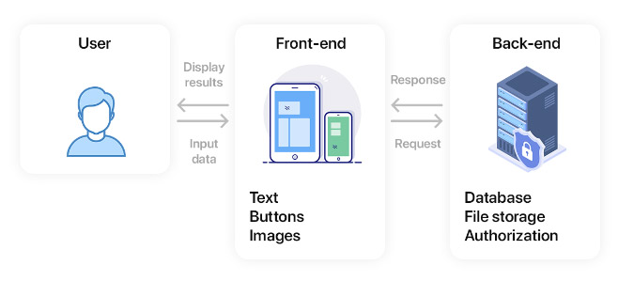
Front and Backend

Slide 137
Web Server

Slide 138
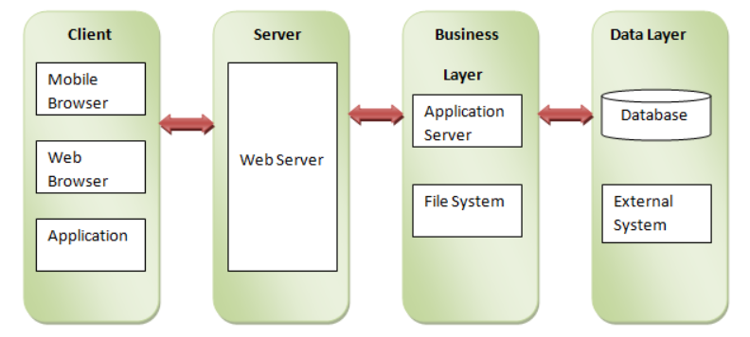
Web Server

Slide 139
To uninstall
Use
npm uninstall <module>
Try ‘npm install express -g’ now !!

Slide 140
MODULES

Slide 141
NODE MODULES
Consider modules to be the same as JavaScript libraries.
A set of functions you want to include in your application.

Slide 142
Step 1
To include a module , use the require() function with the name of the module
var http = require(‘http’)

Slide 143
Step 2
Now your application has access to the HTTP module, and is able to create a server:
var http = require(‘http’)
http.createServer(function (req, res) { res.writeHead(200, {'Content-Type': 'text/html'}); res.end('Hello World!'); }).listen(8080);

Slide 144
Create your own modules

Slide 145
Step 1
Create a module that returns the current date and time with
name of the file “custom_module.js”
exports.myDateTime = function () { return Date(); };

Slide 146
Step 2
Use the module “custom_module.js" in a Node.js file:
var http = require('http');
var dt = require('./custom_module.js');
http.createServer(function (req, res) {
res.writeHead(200, {'Content-Type': 'text/html'});
res.write("The date and time are currently: " + dt.myDateTime() + "<br>");
res.write(dt.myCustomMessage());
res.end();
}).listen(8080);
// Console will print the message
console.log('Server running at http://127.0.0.1:8080/');

Slide 147
File system Module

Slide 148
File system
Read files
Create files
Update files
Delete files
Rename files

Slide 149
To include the file system module , use the require() method
var fs = require('fs');

Slide 150
Write into a File
Writing data into this file using Node.js
const fs = require('fs');
const content = 'Writing data into this file using Node.js';
fs.writeFile('test.txt', content, err => {
if (err) {
console.error(err);
}
console.log('File written successfully!');
});
Test.txt

Slide 151
Read File
Writing data into this file using Node.js
const fs = require('fs');
// read file
fs.open('test.txt', 'r', (err, fd) => {
if (err) {
if (err.code === 'ENOENT') {
console.error('File does not exist');
return;
}
throw err;
}
console.log('File opened successfully and the content is:');
console.log("'"+fs.readFileSync(fd).toString()+"'");
});
Test.txt

Slide 152
Update File
const fs = require('fs');
// update file
fs.open('test.txt', 'r+', (err, fd) => {
if (err) {
if (err.code === 'ENOENT') {
console.error('File does not exist');
return;
}
throw err;
}
fs.writeFile(fd, 'Updated content of test file with content', 'utf8', (err) => {
if (err) {
console.error(err);
return;
}
console.log('File updated successfully!');
});
});
Updated content of test file with content
Test.txt

Slide 153
Delete File
Updated content of test file with content
var fs = require('fs');
var filePath = './test.txt';
fs.unlinkSync(filePath);
Test.txt

Slide 154
Read Files using HTTP server

Slide 155
Read Files and serve them using node JS
<html> <body> <h1>My Header</h1> <p>My paragraph.</p> </body> </html>
var http = require('http'); var fs = require('fs'); http.createServer(function (req, res) { fs.readFile('demofile.html', function(err, data) { res.writeHead(200, {'Content-Type': 'text/html'}); res.write(data); return res.end(); }); }).listen(8080);
// Console will print the message
console.log('Server running at http://127.0.0.1:8080/');
Contents of demofile.html

Slide 156
Using Express

Slide 157
Express
Small framework that works on top of Node.js
Makes it easier to organize your application’s functionality
Helpful utilities to Node.js HTTP objects
Facilitates the rendering of dynamic HTTP objects

Slide 158
Create a simple In-Memory Todo application

Slide 159
Step 1
Install all the required modules
npm install express multer -g

Slide 160
Step 2
Import all the modules and setup the app
In ‘index.js’
// require the express module
const express = require('express');
// create an instance of express to serve our end points
var app = express();
// require the use of multer
var multer = require('multer');
var upload = multer();
// for parsing multipart/form-data
app.use([upload.array(),express.json()]);

Slide 161
Step 3
Create a simple “GET” Endpoint
// create a default set of tasks to do
var tasks = [
'Wake up',
'Eat breakfast',
'Code all day',
'Sleep'
];
// get all the tasks
app.get('/tasks', function (req, res) {
res.json(tasks);
});

Slide 162
Step 3
Create a simple “POST” & “PUT” Endpoint
// add a new task with data passed in request body
app.post('/tasks', function (req, res) {
var requestData = req.body
tasks.push(requestData.task);
res.json(tasks);
});
// update a task
app.put('/tasks/:id', function (req, res) {
var id = req.params.id;
var updatedTask = req.body.task;
tasks[id] = updatedTask;
res.json(tasks);
});

Slide 163
Step 4
Finish up the application
// listen on port 3100
app.listen(3100, function () {
console.log('Example app listening on port 3100!');
});

Slide 164
Databases

Slide 165
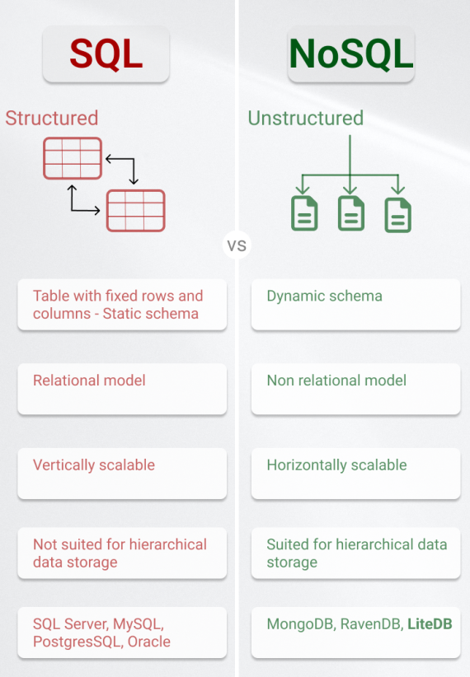

Slide 166
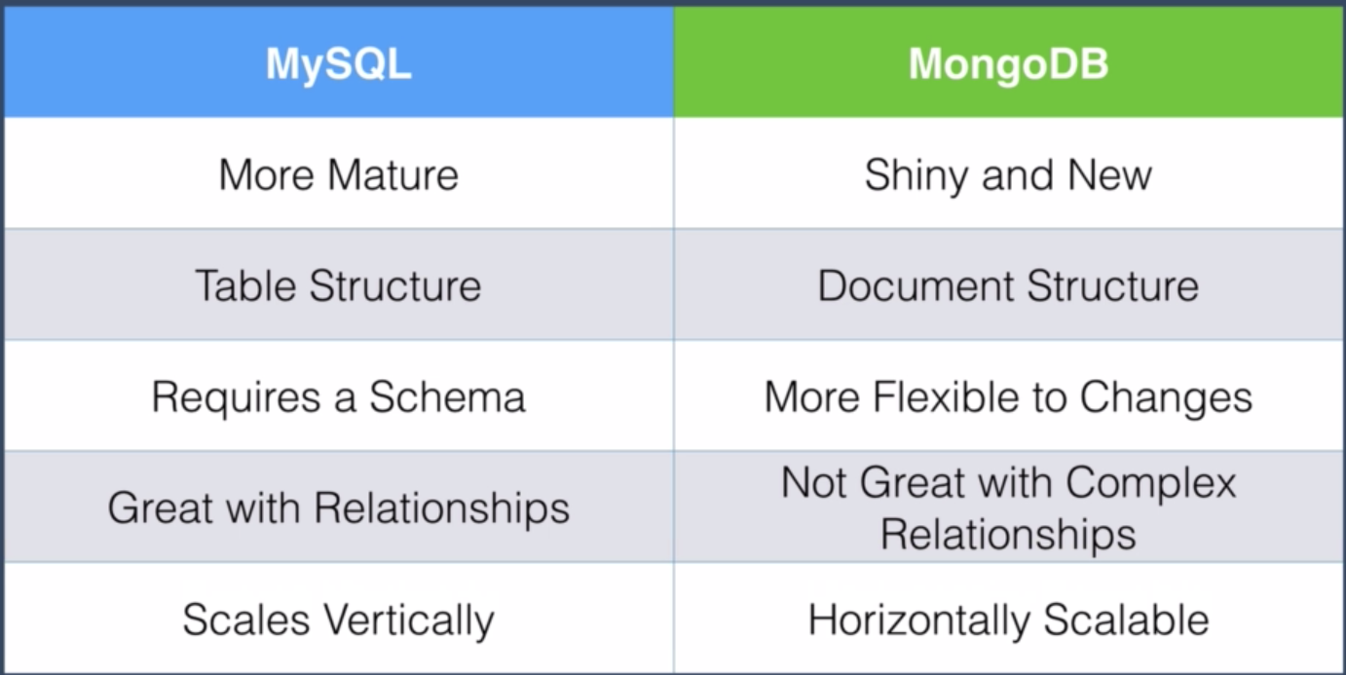

Slide 167
Database Connections in Node JS

Slide 168
Database connections
For each database node requires different modules
Mysql
require('mysql');
MongoDB
Require(‘mongodb’);
Sqlite3
Required(‘sqlite`);

Slide 169
Create a simple databased backed Todo application

Slide 170
Step 1
Install all the required modules
npm install express multer cors mongodb --save

Slide 171
Step 2
Import all the modules and setup the app
// require the express module
const express = require('express');
// require the cors module
const cors = require('cors');
// create an instance of express to serve our end points
var app = express();
// require the use of multer
var multer = require('multer');
var upload = multer();
// use the express-static middleware
app.use([upload.array(), express.json(),cors()]);

Slide 172
Step 3
Setup up the database connections

Slide 173
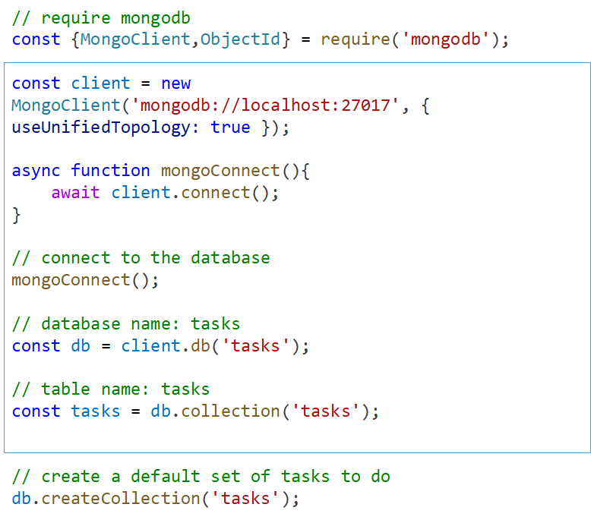
Contd.

Slide 174
Contd.
// prepopulate the tasks collection
async function populateCollection(){
if (await tasks.countDocuments() !== 0) return;
await tasks.insertMany([
{task: 'Buy some milk',status: 'not_started'},
{task: 'Pick up the kids',status:'not_started'},
{task: 'Send out invitations',status:'not_started'},
{task: 'Book a hotel for the party',status:'not_started'},
{task: 'Call the plumber',status:'not_started'}
]);
}
populateCollection();

Slide 175
Step 2
Creating “GET” Endpoints
// get a list of tasks
app.get('/tasks', function (req, res) {
async function getTasks(){
const cursor = await tasks.find();
const results = await cursor.toArray();
res.json(results);
}
return getTasks();
}); // get a single task
app.get('/tasks/:id', function (req, res) {
const id = req.params.id;
const mongoId = new ObjectId(id);
async function getTask(){
const result = await tasks.findOne({_id: mongoId});
res.json(result);
}
return getTask();
});

Slide 176
Step 3
Creating “POST” Endpoint
// add a task
app.post('/tasks', function (req, res) {
async function addTask(){
const result = await tasks.insertOne({task: req.body.task, status: 'not_started'});
res.json({task: req.body.task, status: 'not_started', _id: result.insertedId});
}
return addTask();
});

Slide 177
Step 4
Creating “DELETE” Endpoint
// delete a task
app.delete('/tasks/:id', function (req, res) {
const id = req.params.id;
const mongoId = new ObjectId(id);
async function deleteTask(){
const result = await tasks.deleteOne({_id: mongoId});
res.json({message: 'Task deleted for id ' + id});
}
return deleteTask();
});

Slide 178
Step 4
Creating “PUT” Endpoint
// update a task status
app.put('/tasks/:id/status', function (req, res) {
const id = req.params.id;
const mongoId = new ObjectId(id);
async function updateTaskStatus(){
const result = await tasks.updateOne({_id:mongoId}, {$set: {status: req.body.status}});
if (result.modifiedCount === 0){
return res.json({message: 'Nothing to update'});
}
res.json({message: 'Task status updated for id ' + id});
}
return updateTaskStatus();
});

Slide 179
Step 5
Finish starting up the application
// start the server listening on port 3100\
app.listen(3100, () => {
console.log('Connected to Database, app listening on port 3100');
});

Slide 180
Creating TODO App using Angular JS

Slide 181
Angular JS project structure
Angular-workshop/
│
├── controller/
│ └── app.js
│
├── index.html
└── style.css

Slide 182
Step 1
Create “app.js” in controller folder
var app = angular.module('taskApp', []);
app.controller('TaskController', ['$scope', '$http', function ($scope, $http) {
$scope.tasks = [];
$scope.newTask = '';
$scope.nodeJSServer = 'http://localhost:3100’;
// Function to load all tasks
$scope.loadTasks = function () {
$http.get($scope.nodeJSServer + '/tasks/').then(function (response) {
$scope.tasks = response.data;
});
};
// Initial load of tasks
$scope.loadTasks();
}

Slide 183
Let’s not stop here

Slide 184
A few more projects ideas to carry forward

Slide 185
User-Centric Blogging Platform
Objective: The goal is to develop a blogging platform using the MEAN stack (MongoDB, Express.js, Angular, and Node.js) that offers a balance of simplicity and functionality. The platform should provide an intuitive user experience, allowing users to focus on creating and sharing content rather than navigating the complexities of the software.

Slide 186
User-Centric Blogging Platform
Key Features:
User Authentication: Secure signup and login processes.
Content Management: Tools for creating, editing, and deleting blog posts.
User Profiles: Personalized profiles for users to manage their posts and preferences.
Responsive Design: A mobile-friendly interface that adapts to different devices.
Comment System: Allowing readers to engage with content through comments.
Search Functionality: Enabling users to find content by keywords or categories.

Slide 187
E-commerce platform
Objective: The objective is to develop an e-commerce platform using the MEAN stack (MongoDB, Express.js, Angular, and Node.js) that simplifies the online shopping experience for both customers and sellers. The platform should be scalable, user-friendly, and customizable, catering to the specific requirements of SMEs while ensuring a seamless user experience for shoppers.

Slide 188
E-commerce platform
Product Management: Easy listing, categorization, and management of products.
Shopping Cart and Checkout Process: Intuitive and secure shopping cart functionality with an efficient checkout process.
User Profiles and Order Management: Personalized user profiles for customers and sellers, including order tracking and history.
Responsive Design: A design that is compatible with various devices, enhancing the shopping experience on smartphones, tablets, and desktops.
Payment Gateway Integration: Secure and diverse payment options.
Search and Filter Options: Advanced search and filtering capabilities to easily find products.
Rating and Review System: Feature for customers to rate and review products, aiding others in making informed decisions.

